Slide 1
Climatología dinámica / Climatología física
Práctica 3: Contribución de la temperatura y la humedad en el contenido de energía del aire

Slide 2
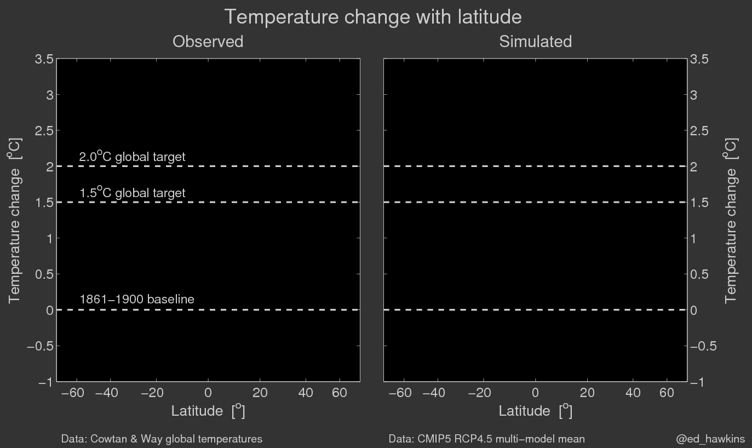

Slide 3
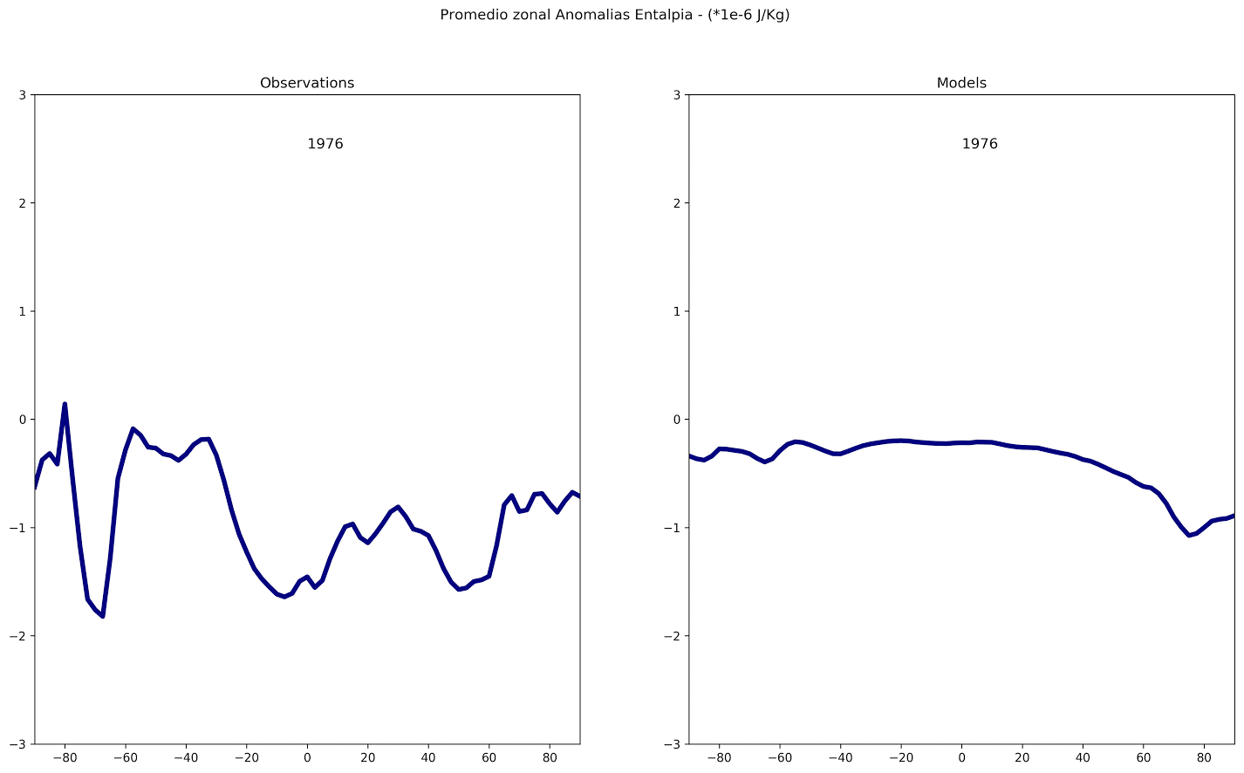

Slide 4
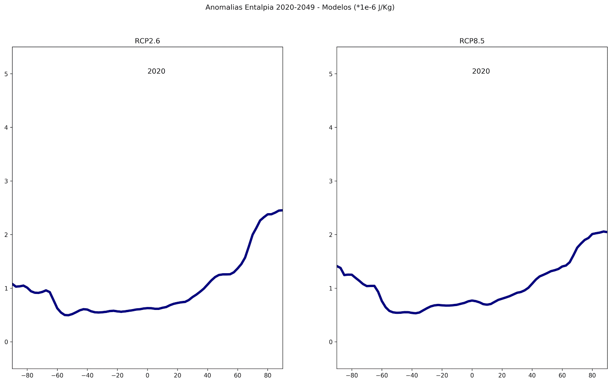

Slide 5
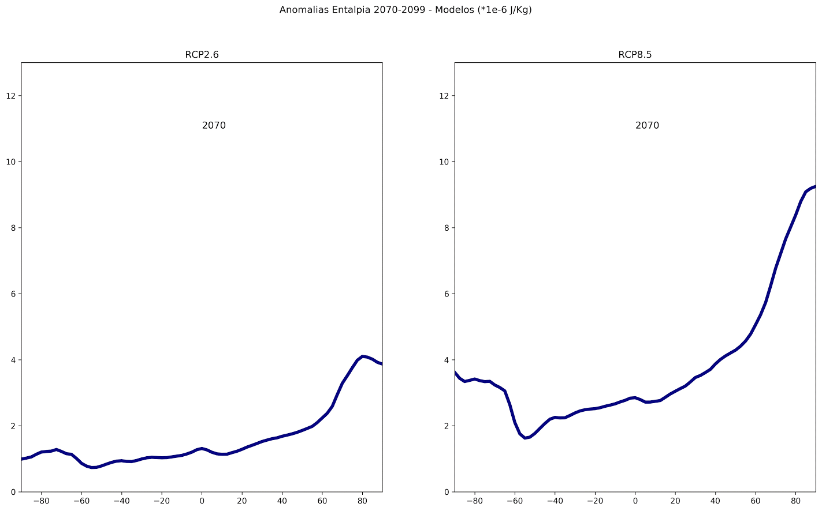

Slide 6
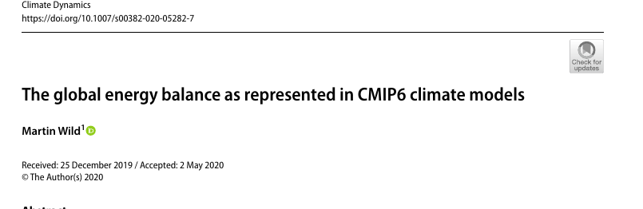
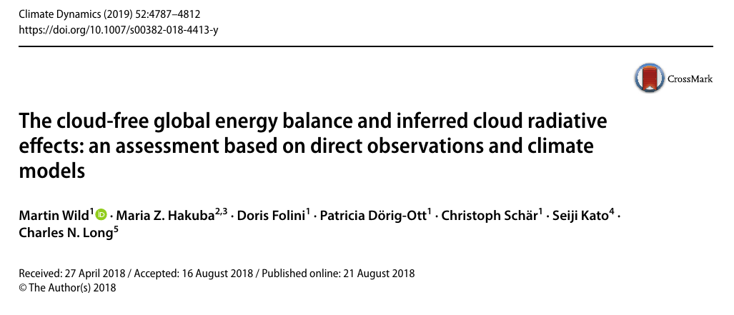

Slide 7
The global energy budgets of the CMIP6 models discussed in this study have been determined as averages over the final 15 years of these simulations (2000-2014) and shall represent present-day conditions at the beginning of the new millennium. To allow for a comparison with the previous model generation CMIP5 evaluated in Wild et al. (2013, 2015, 2019), I also determined the CMIP6 budgets for the averaging period 2000–2004 used in these former studies. For the global mean budgets, the differences induced by the different averaging periods (2000–2014 versus 2000–2004) were, however, insignificant (< 0.3 Wm−2)

Slide 8
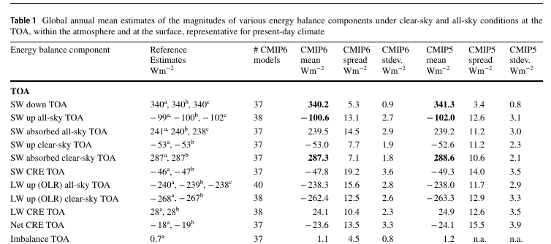

Slide 9
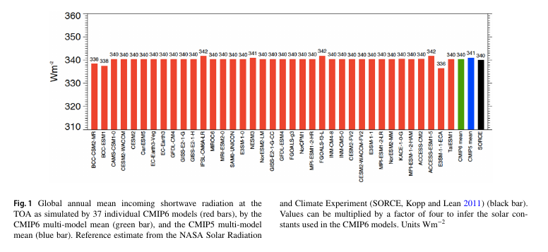

Slide 10
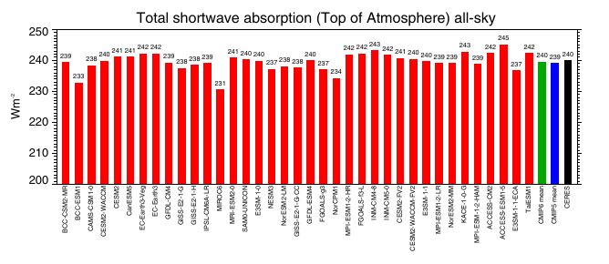
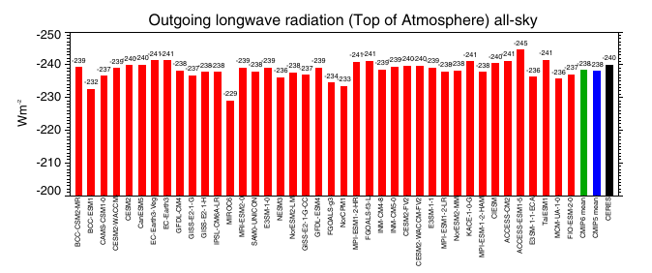

Slide 11
. The inter-model spread in the simulated global mean OLR is even considerably larger in CMIP6 than in CMIP5, and also in terms of standard deviations, the CMIP6 models differ as much or more in their longwave budgets as their CMIP5 counterparts. In terms of absolute magnitudes, the CMIP6 multi-model mean, at 238.3 ­Wm−2 nearly matches the CMIP5 multi-model mean estimate, and is close to the satellite-based reference values of 240 ± 3 ­Wm−2 (Table 1).

Slide 12
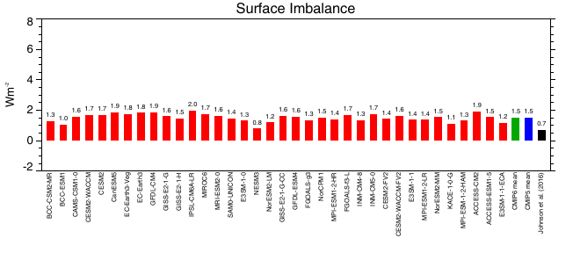
Most of this energy goes into the oceans, while a small fraction is stored in the terrestrial sub-surfaces and used for the melting of snow and ice. All models show a positive surface imbalance as expected with increasing greenhouse-gas forcing, with values mostly between 1 and 2 W­ m−2, and a multi-model mean of 1.5 ­ Wm−2 (Table 1, Fig. 6, lower panel). This is slightly higher than the reference values which are somewhat below 1 W m−2 (Hansen et al. 2005; von Schuckmann et al. 2016; Johnson et al. 2016), again potentially due to imperfect energy conservation in the models (Hourdin et al. 2017).

Slide 13
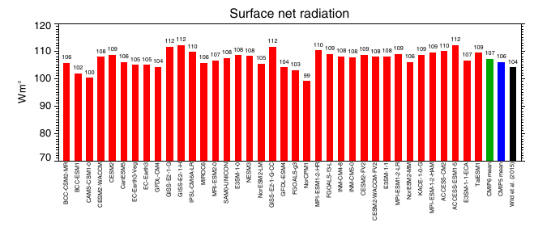

Slide 14
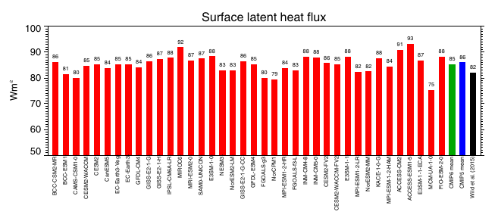
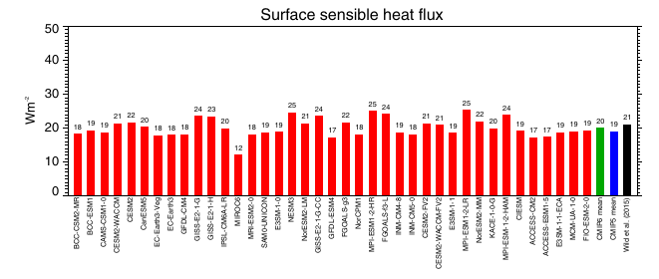

Slide 15
The individual CMIP6 models on the other hand differ in their simulated global mean latent heat fluxes by up to 18 ­Wm−2, which corresponds to a spread of as much as 21%,considering the multi-model mean latent heat flux of 85 ­Wm −2.
This implies that the simulated global mean precipitation between the individual CMIP6 models also must have the same spread of 21%, or, in other words, the intensity of the global water cycle simulated by the different CMIP6 models varies in range of more than 20%). This is even larger than amongst the 43 CMIP5 models, where the intensity of the water cycle in terms of their global latent heat fluxes varied in a range of 16% (14 ­ W m−2).
However, the global mean sensible heat fluxes in individual CMIP6 models vary in a range of 13 ­Wm−2, which corresponds to a spread of as much as 65% (Fig. 7, lower panel, Table 1). This wide spread reflects the considerable uncertainties still inherent in the quantification of the sensible heat fluxes in climate models.

Slide 16
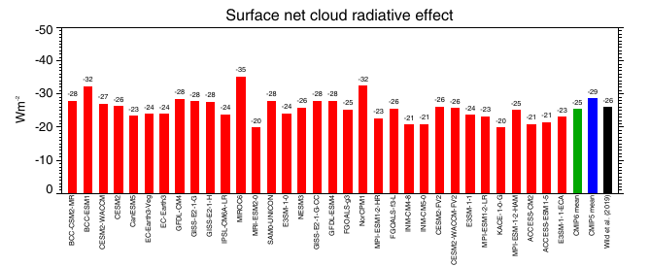

Slide 17
Clouds globally reduce the longwave emission to space by 24.1­Wm−2 (TOA longwave CRE) in the CMIP6 multi-model mean, causing a gain of energy for the climate system.
The enhanced shortwave reflection of − 47.8 ­ W m−2 thus globally dominates over the longwave energy gain of 24.1 ­Wm−2 in the CMIP6 multi-model mean, which implies an overall energy reduction of − 23.7 ­Wm−2 for the climate system
The effect of clouds on the absorption of shortwave radiation at the Earth’s surface (surface shortwave CRE) in the CMIP6 multi-model mean is a global mean reduction of − 51.2 ­Wm−2
The effect of clouds on the longwave surface balance is to reduce the surface cooling by 25.5 ­Wm−2 globally in the CMIP6 multi-model mean, nearly matching its CMIP5 counterpart.
As a net effect at the Earth’s surface (surface net CRE), the presence of clouds reduces the available energy by − 25.4 ­Wm−2 in the CMIP6 multi-model mean globally, since the energy gain for the surface in the longwave does not compensate the energy loss in the shortwave.

Slide 18
